Slide 1
Tesla, Inc. (TSLA): Should the Fund Initiate a Position?
Project 1 Valuation for the Investment Committee
By Erlan Jones
FIN 43900

Slide 2
Should We Buy Tesla?
Simple answer, Not Yet
Tesla’s current business is worth about $15-$20 per share (base case $16.54)
The other $336 of the price is a bet on Robotaxi and AI, which isn’t proven yet
Horizon: 3-5 years (Review Every Quarter)

Slide 3
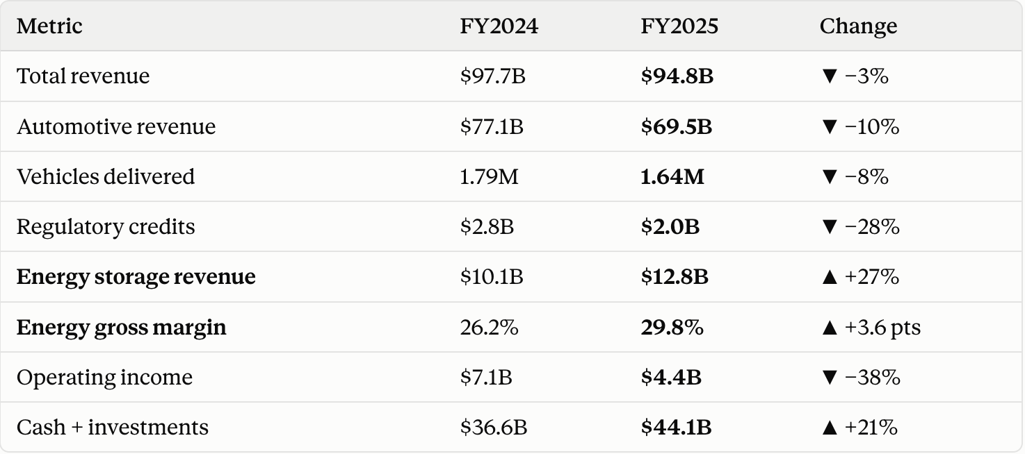
Tesla in 2025
Cars slowed down. Energy took off.
Next: Tesla plans $20B+ of capex in 2026 (vs. $8.5B in 2025).
Source: Tesla FY2024 and FY2025 Form 10-K.

Slide 4
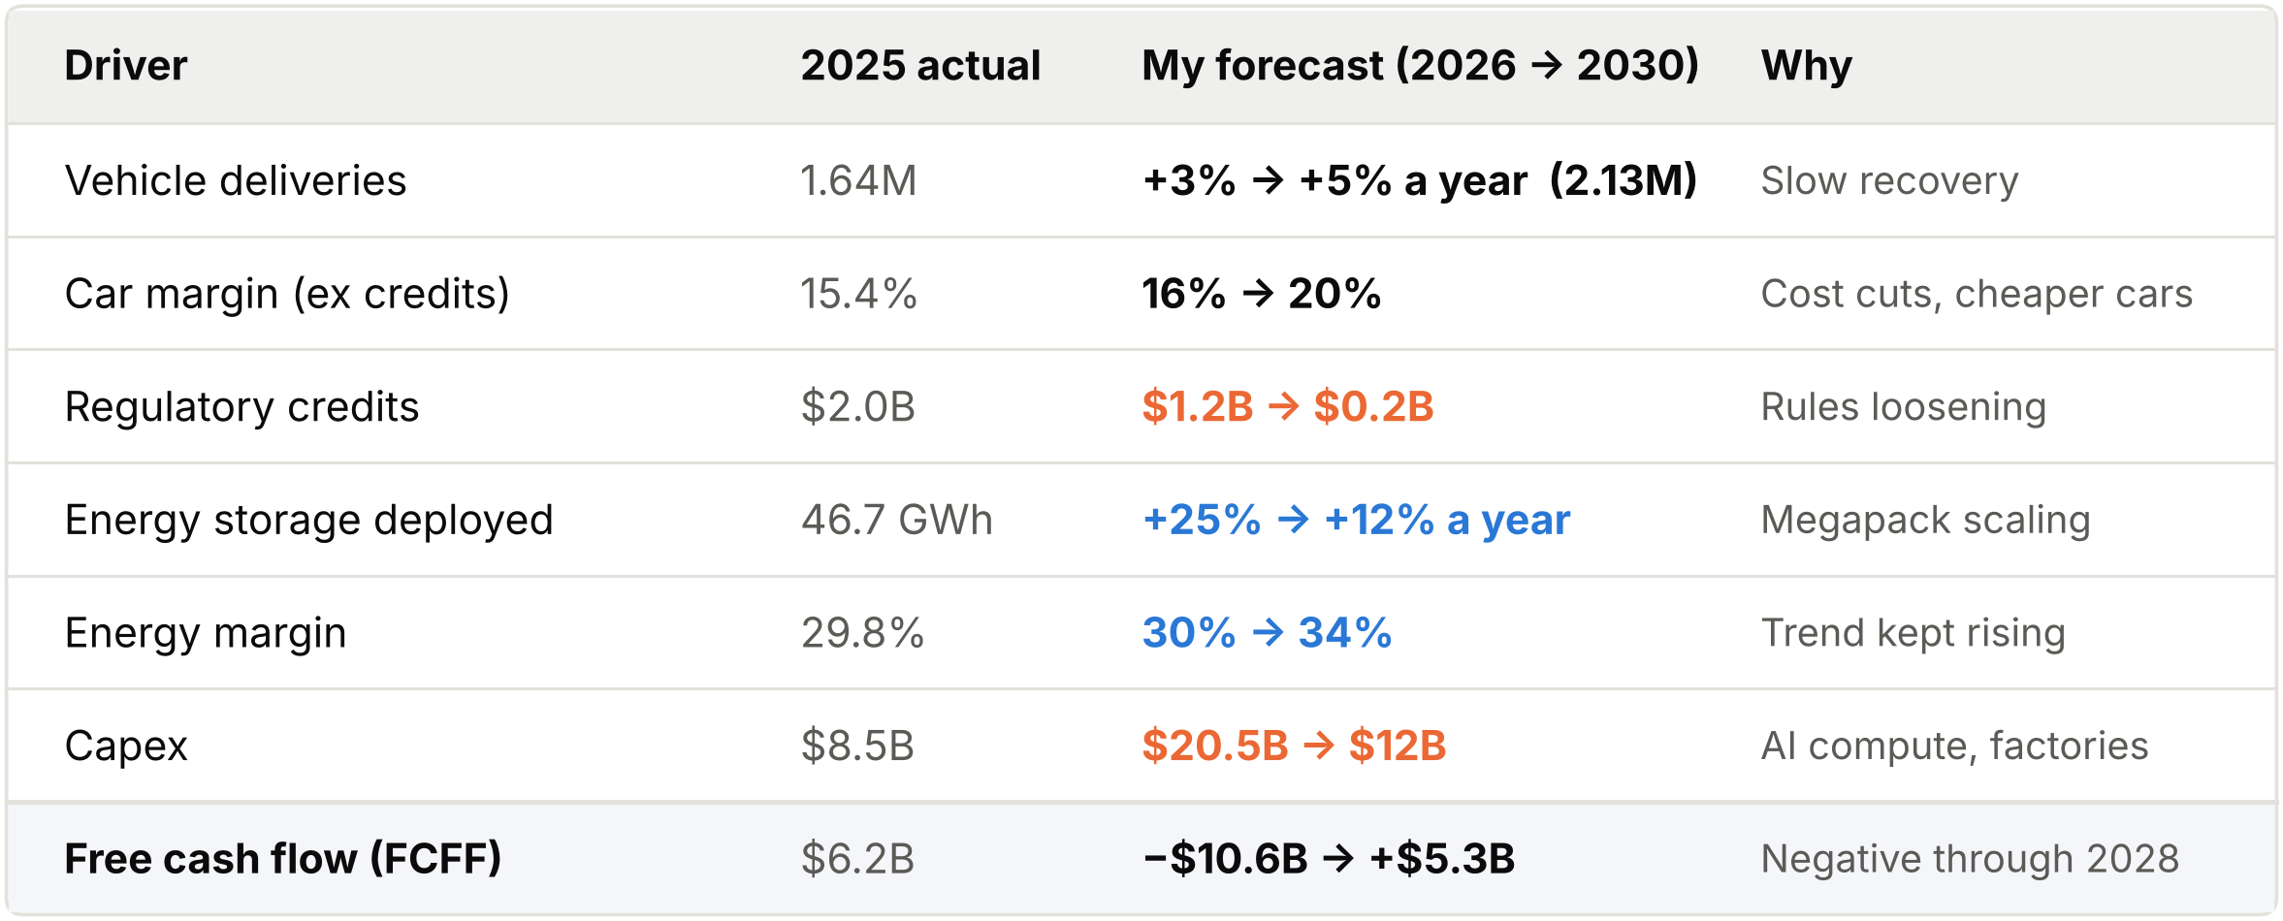
What Drives My Forecast

Slide 5
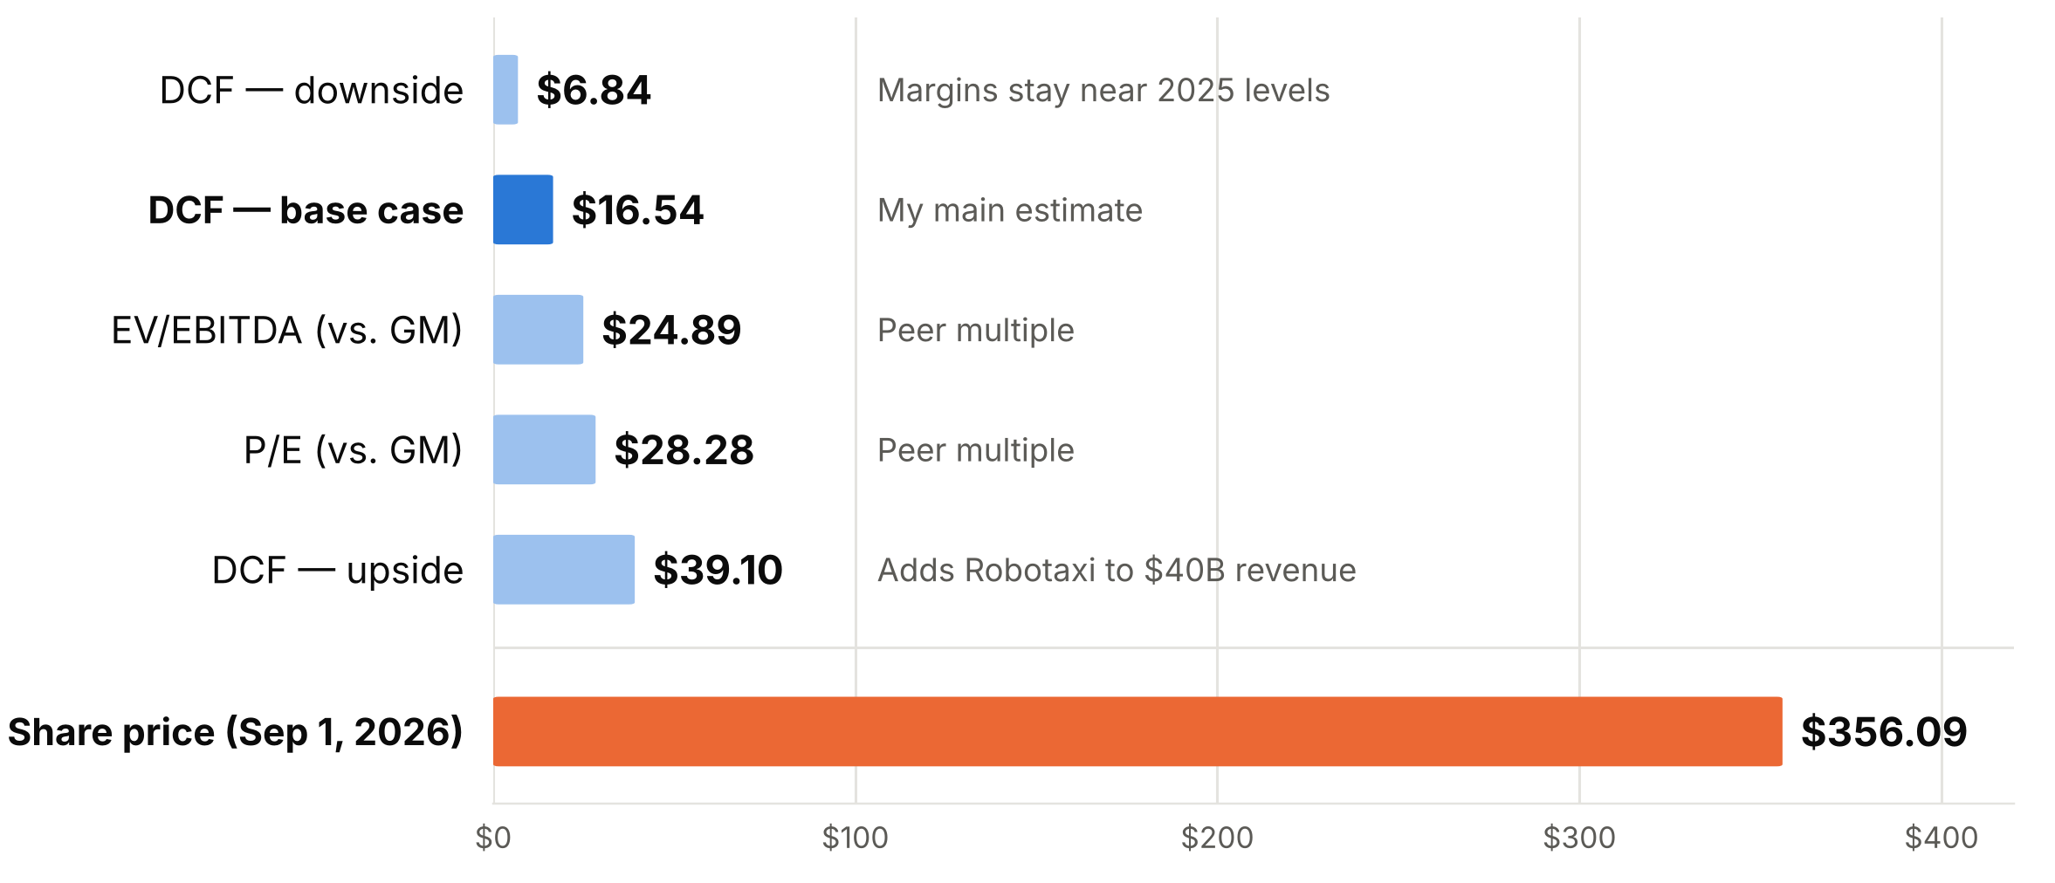
What is Tesla Worth?
Every method lands far below $356

Slide 6
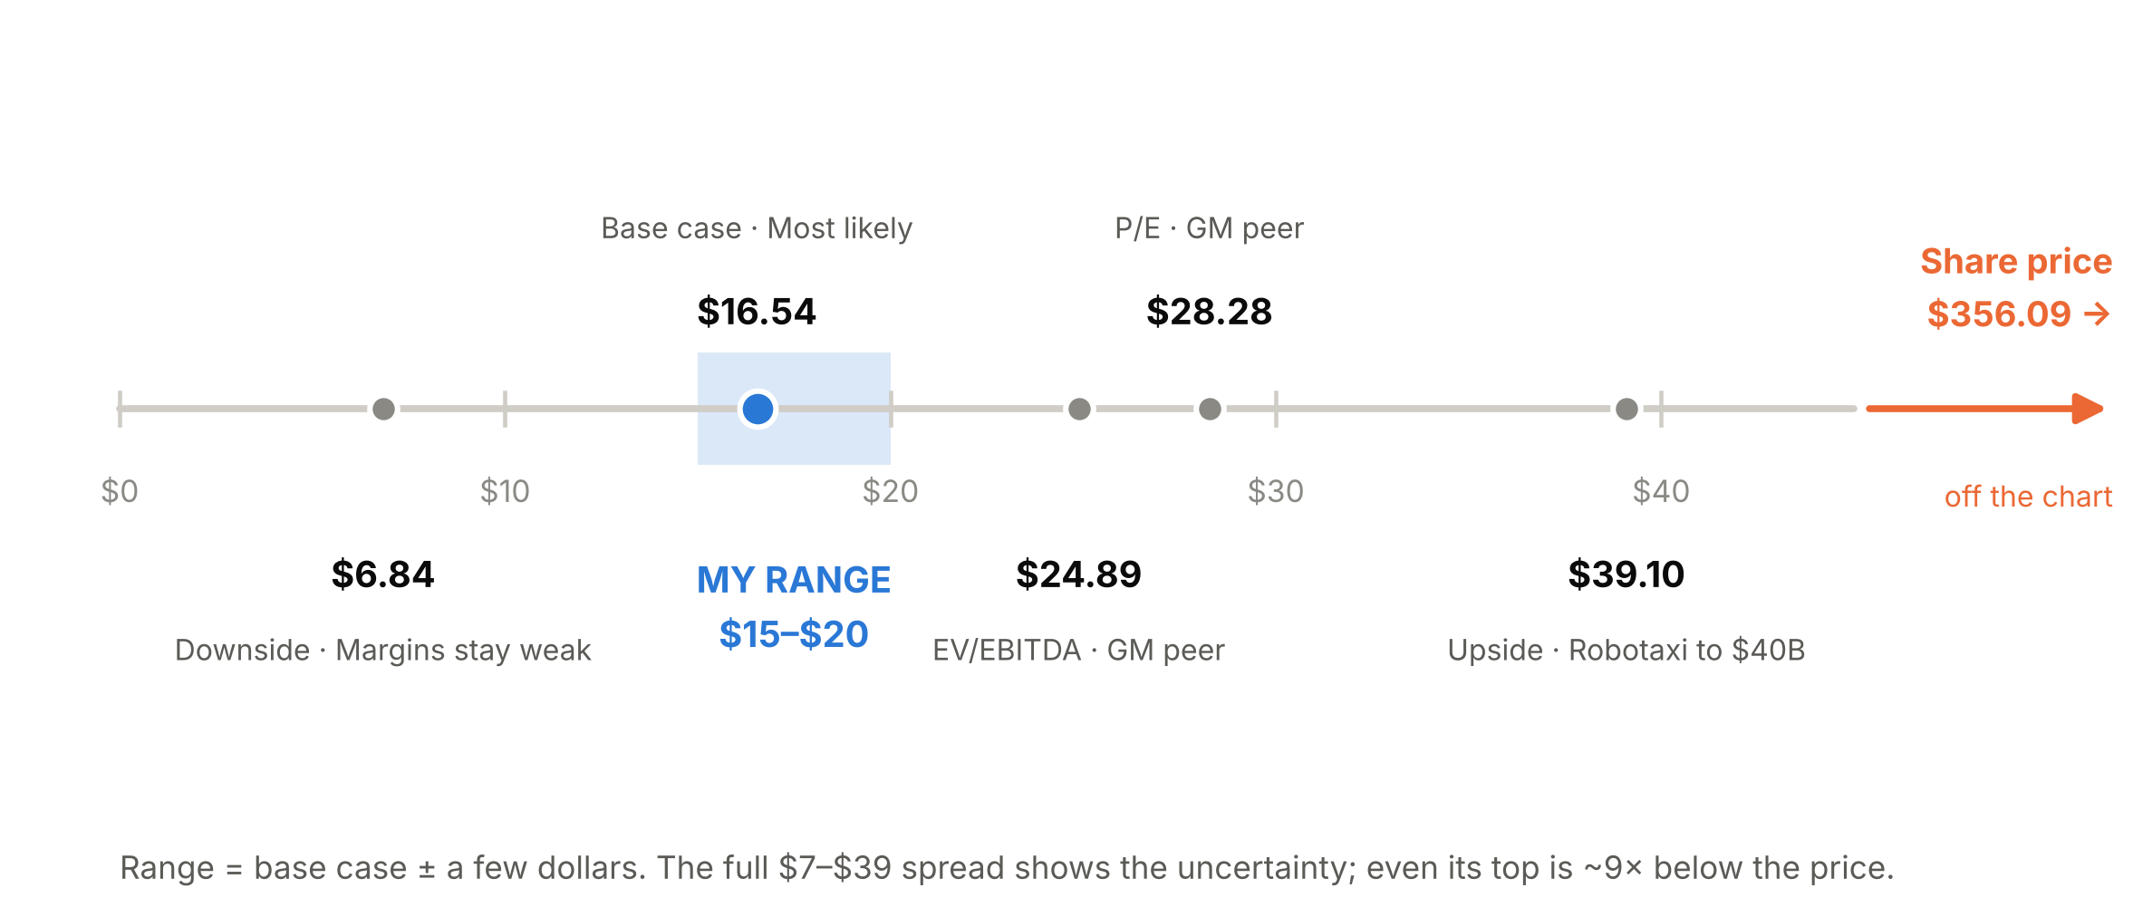
So, Why Did I Choose $15-$20

Slide 7
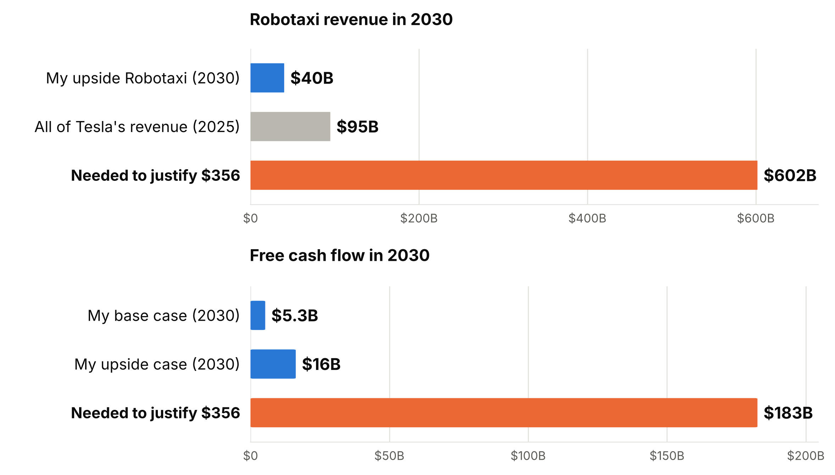
What Does $356 Assume?
The price only works if Robotaxi becomes enormous.

Slide 8
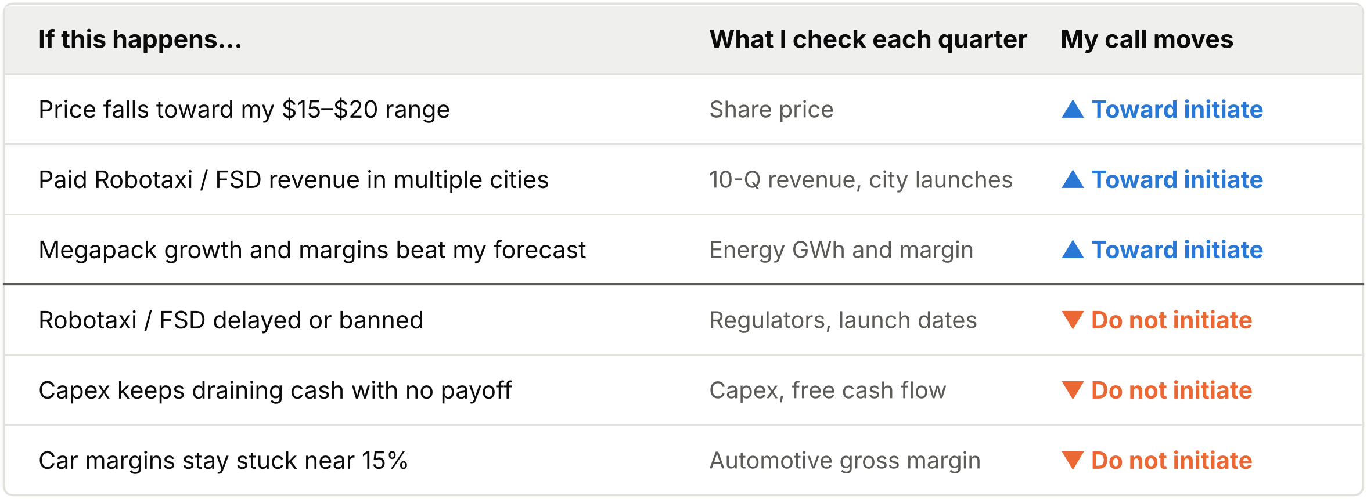
What Would Change My Mind?

Slide 9
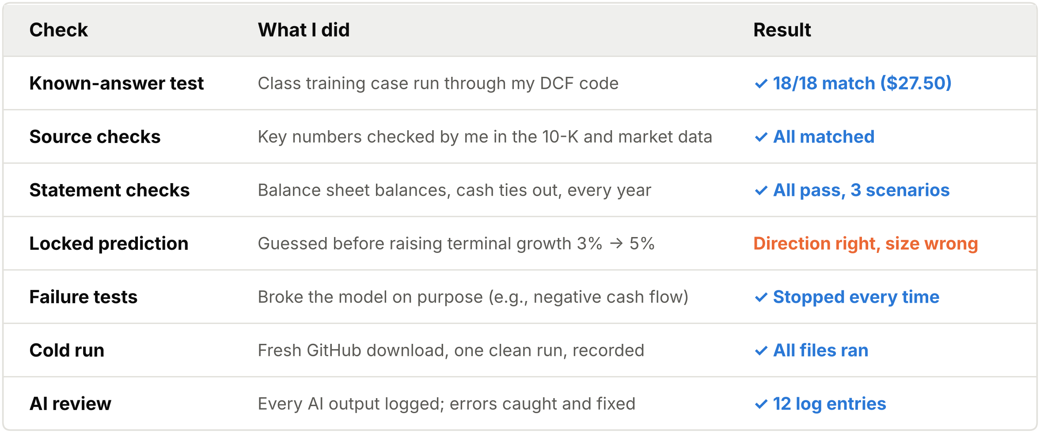
How I checked the work
I tested the model before trusting it

Slide 10
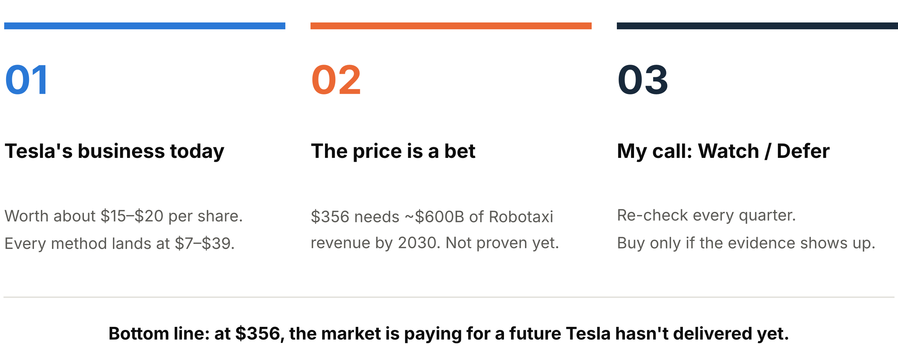
Key Takeaways

